Slide 1

Liquid Water & juice🥤
By Rohan and
illustrated by Rohan
Notes:
It will be fun in the end

Slide 2
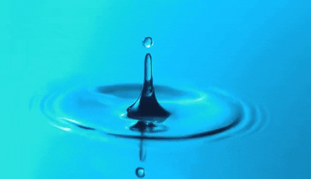
Water is just a normal liquid
Water is a liquid.it is the normal drink

Slide 3
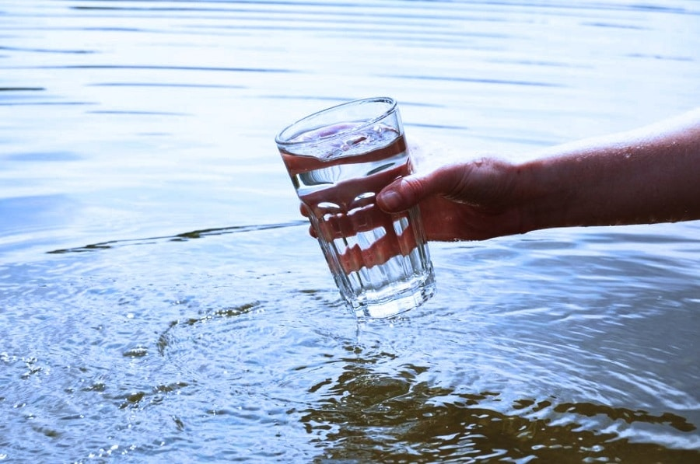
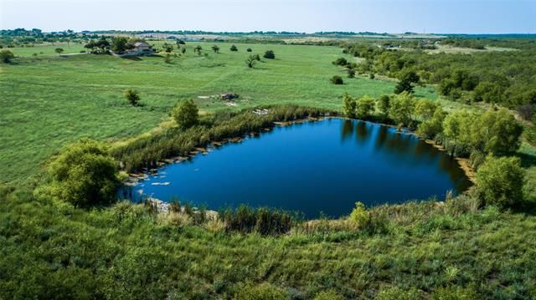
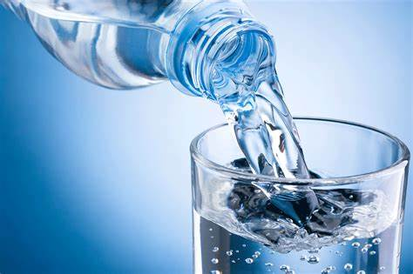
There is different types of water
Like salt water and fresh water dinking water

Slide 4
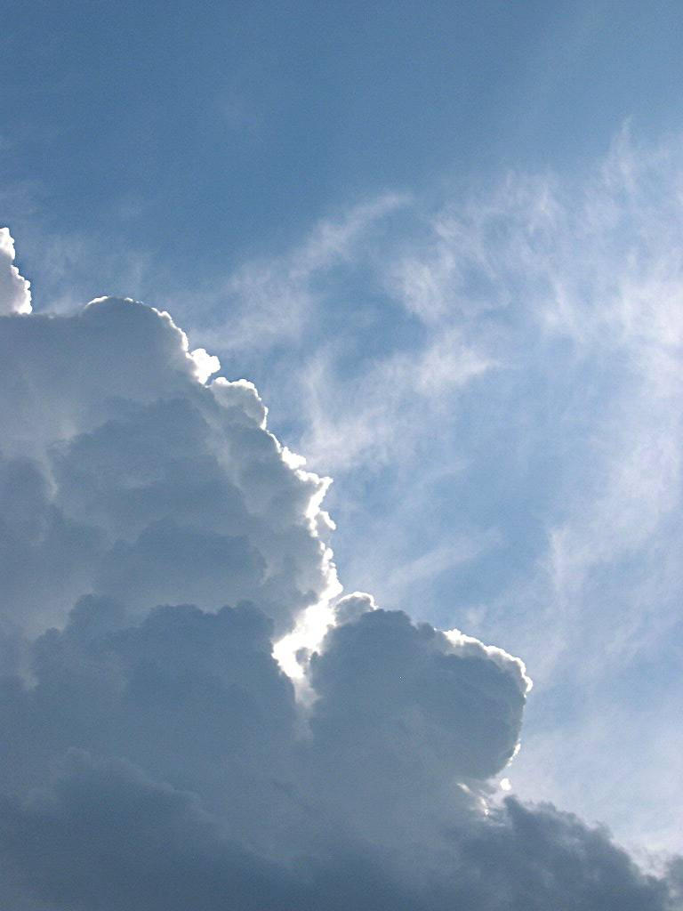

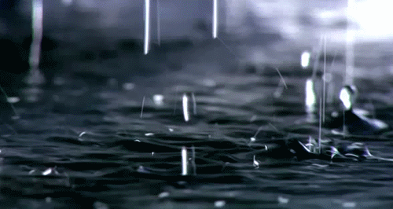
Water also come from clouds but in drops

Slide 5
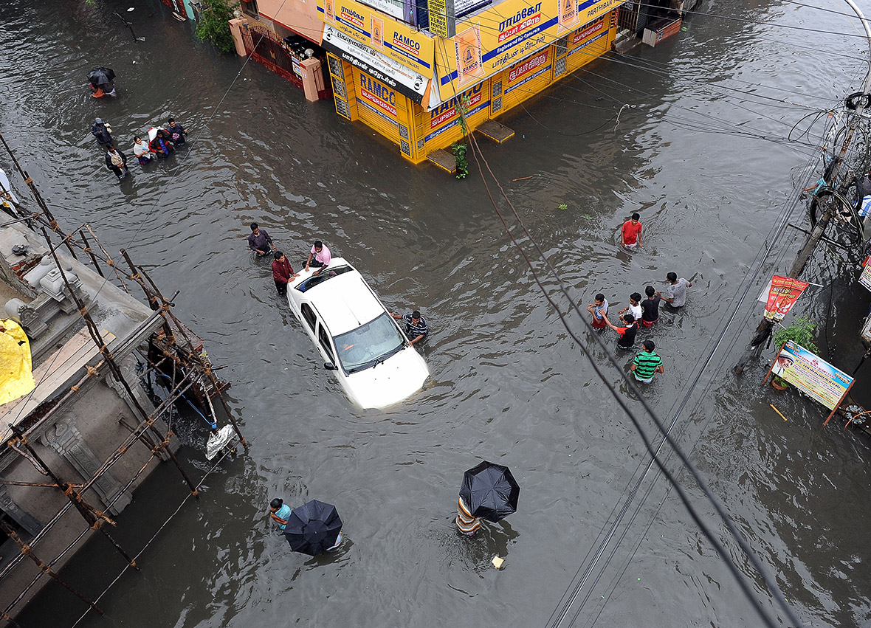
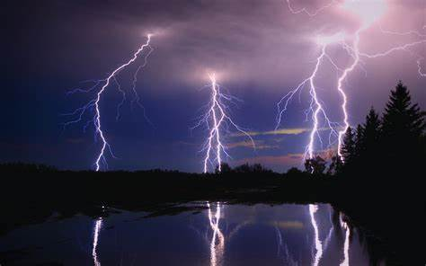
Clouds shots water.
Sometimes it will floud because too much
Water may come and won’t have space
So it will just stay there
Sometimes water comes from clouds
So sometimes it will have bad whether
So it will be a storm

Slide 6
There is another sweat liquid thane water.
And the another sweat liquid is juice 🥤

Slide 7
There is deferent types of juice 🥤 and it will not come from cloud 🌥
And it will come from fruits🍓🍒🍎😎🧃🥤

Slide 8
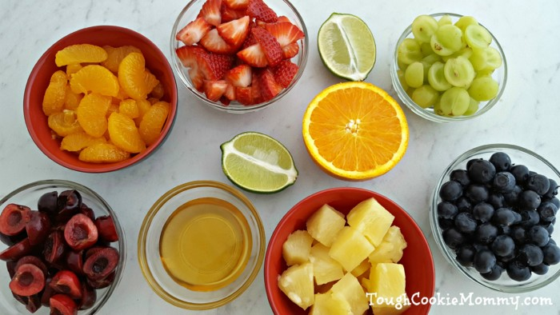
So now it is all about juice 🥤 so we will not make it. as you already know
So fruits will make It but deferent fruits wll make it deferent
Flavour

Slide 9
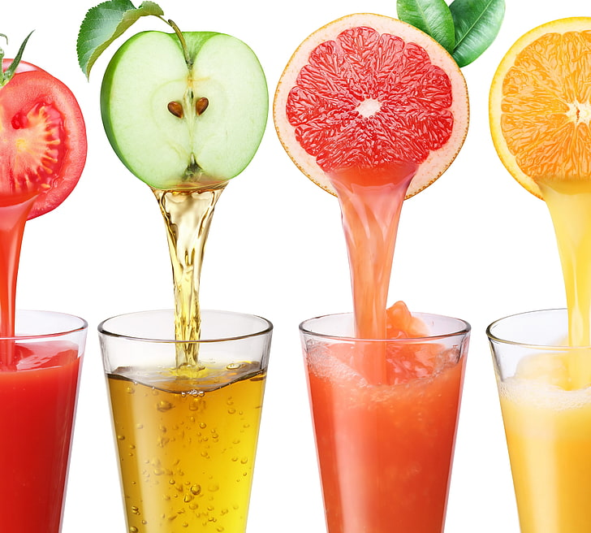

So what kind of flavor there are???
Always the flavor whod be the flavor of the fruit

Slide 10

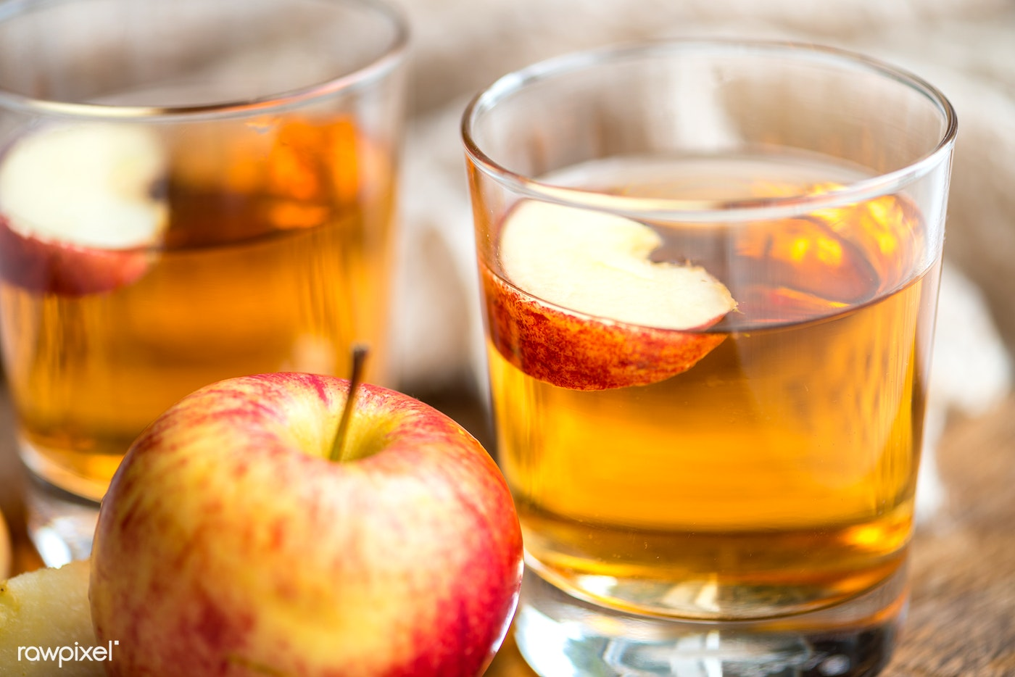
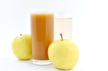
Some juice 🥤 has chemicals
This is apple juice 🥤 whit chemicals
This is apple juice 🥤 without chemicals

Slide 11



